Slide 1

Literature Sources Analysis Using Deep Impostor Approach
Presented by: Ofir Uziel, Emanuel Davidov
Supervisor: Prof. Zeev Volkovich, Dr. Renata Avros

Slide 2





Table of Contents
Problem & Solution
Problem Definition, Project Purpose, Proposed Solution Overview
System Architecture
Detailed System Architecture, Data Preparation, Embedding Generation
Models & Implementation
Classification Models, Signal Construction, Boundary Detection, UML Diagrams, Implementation Workflow
Evaluation & Conclusion
Testing Plan, Innovation, Applications, Evaluation Methodology, Summary and Future Directions

Slide 3

Problem Definition
1
Traditional Assumptions
Current methods like stylometry, authorship attribution models, or n-gram analysis typically assume that each document has a single, consistent author. This makes them blind to collaborative works or sections written by editors, causing misleading conclusions.
2
Detection Challenges
Most algorithms classify entire documents, but stylistic shifts can happen within them. for example, between a letter's introduction and its body, or when content is copied from multiple sources. These internal boundaries go undetected.
3
Technical Limitations
Existing approaches rely on labeled data (known authorship), which is rare. They also produce opaque results that lack interpretability, especially when used on unseen or composite texts.

Slide 4





Project Purpose
Unsupervised Framework
Alternation Point Detection
Train classifiers using unrelated “impostor” corpora, without labeled examples from the target document. This makes the method flexible and domain-independent.
Identify where the writing style changes inside a single document. These shifts may indicate author boundaries, edits, or insertions.
Noise Filtering
Interpretable Visualization
Remove small fluctuations or false stylistic deviations using aggregation and signal smoothing, so only major stylistic boundaries are detected.
Provide visual plots of stylistic signals over the document timeline, clearly marking detected boundaries for human inspection.
Our goal is to build a system that can detect internal stylistic boundaries in documents, without relying on pre-labeled data. By training deep classifiers on unrelated impostor texts and analyzing classifier behavior across the document, we can detect stylistic shifts, filter noise, and visualize transitions to support forensic or editorial analysis.

Slide 5

Proposed Solution Overview
1
Deep Impostor Method
2
Stylistic Classification
Based on the method introduced by Avros and Volkovich, we train a deep neural model to distinguish between two unrelated “impostor” corpora. This classifier learns a strong stylistic boundary, which we then use to evaluate each chunk of the target document and track how its style shifts over time.
Apply the trained impostor classifier to batches from the target document. Each batch receives a probability score indicating its alignment with one of the two impostors.
3
Signal Generation
4
Multiview Detection
Aggregate batch predictions into chunk-level scores, forming a 1D signal representing how stylistic alignment changes across the document.
Repeat the entire process across many impostor pairs. Apply statistical changepoint detection (including wavelet transforms), and confirm stylistic boundaries only where multiple classifiers agree.

Slide 6

Detailed System Architecture
1
Text Segmentation
2
Word Embedding
Split documents into fixed-length batches, then group batches into larger chunks. Each chunk will become a unit of stylistic analysis.
Convert text batches to vector representations using either Word2Vec or BERT, depending on the classifier.
3
Stylistic Classification
4
Signal Creation Analysis
Train a binary classifier on each impostor pair. Apply it to every chunk in the target document to produce a stylistic probability score.
Combine the per-chunk classifier outputs to form a signal representing stylistic alignment over the document. Apply rolling distance and wavelet transform to identify stylistic shifts.
5
Boundary Detection
Run multiple classifiers using different impostor pairs. Use voting to detect consistent peaks across models. Only peaks with broad agreement are marked as final stylistic boundaries.
The system architecture integrates multiple components working in sequence to process text, generate meaningful representations, and identify stylistic boundaries through sophisticated analysis techniques.

Slide 7

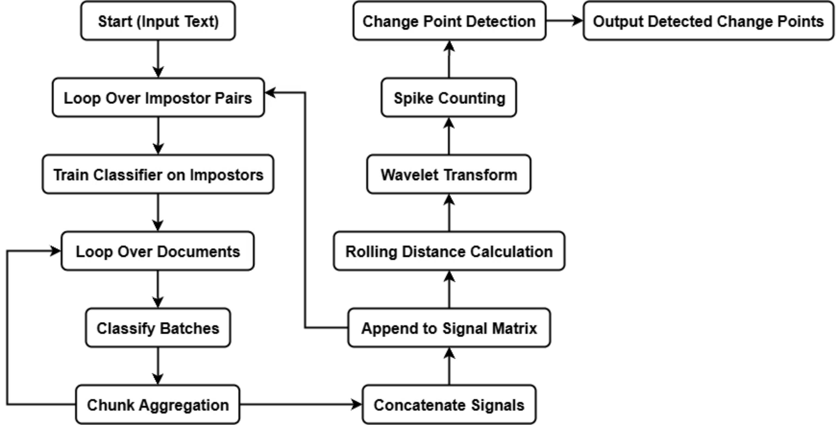
General Model FlowChart

Slide 8




Data Preparation
Document Input
Tokenization
Chunking
Raw text documents
Fixed-length batches (e.g. 50 words)
Several batches per chunk (e.g. 400 words)
The data preparation process ensures consistent, structured input for the stylistic modeling system. By breaking documents into standardized units, we create uniform segments that can be effectively analyzed for stylistic patterns and variations.
This systematic approach allows for more reliable comparison across different parts of a document, enabling the detection of subtle stylistic shifts that might indicate changes in authorship or significant editorial intervention.

Slide 9

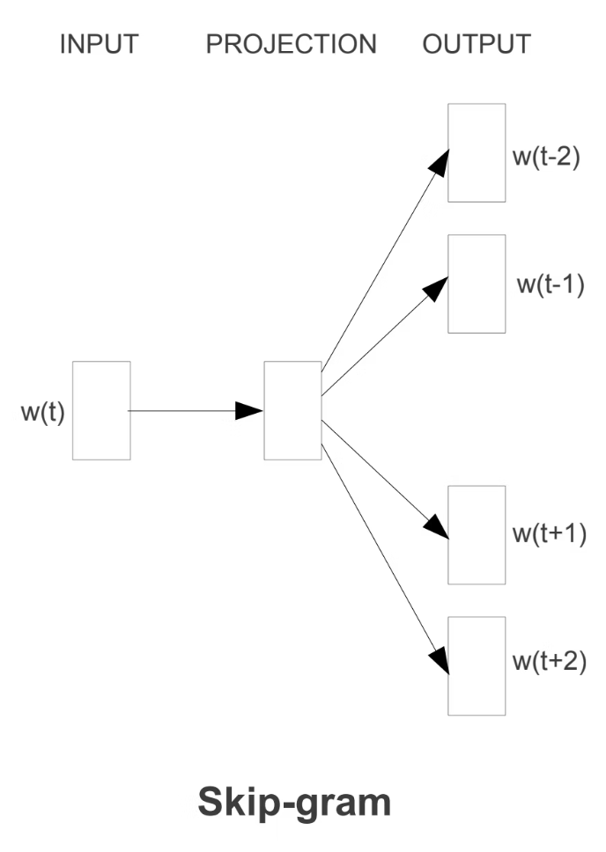
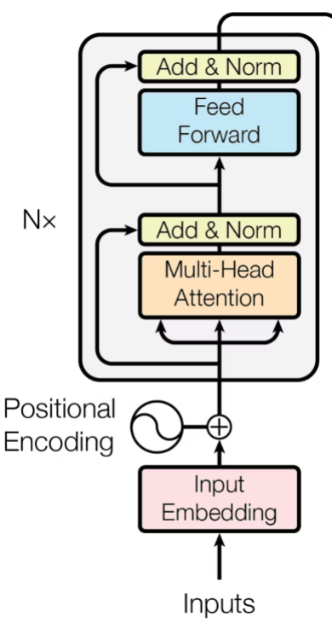
Embedding Generation
Word2Vec (Skip-Gram)
A computationally efficient embedding technique that captures lexical-level features by predicting context words from target words.
BERT (Transformer)
A context-sensitive embedding approach that captures sentence-level semantics through bidirectional attention mechanisms.
Captures word relationships
Context-aware representations
Efficient processing
Captures semantic nuances
Strong lexical representation
Pre-trained on massive corpora
Both embedding techniques transform text into numerical vectors that represent semantic and stylistic properties. These vectors are then used as inputs to our classification models, which learn to detect stylistic differences. Together, Word2Vec and BERT ensure broad coverage of both surface-level and deep semantic stylistic cues.

Slide 10

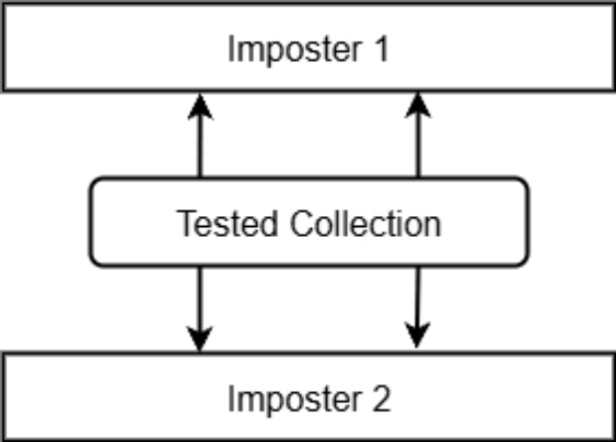
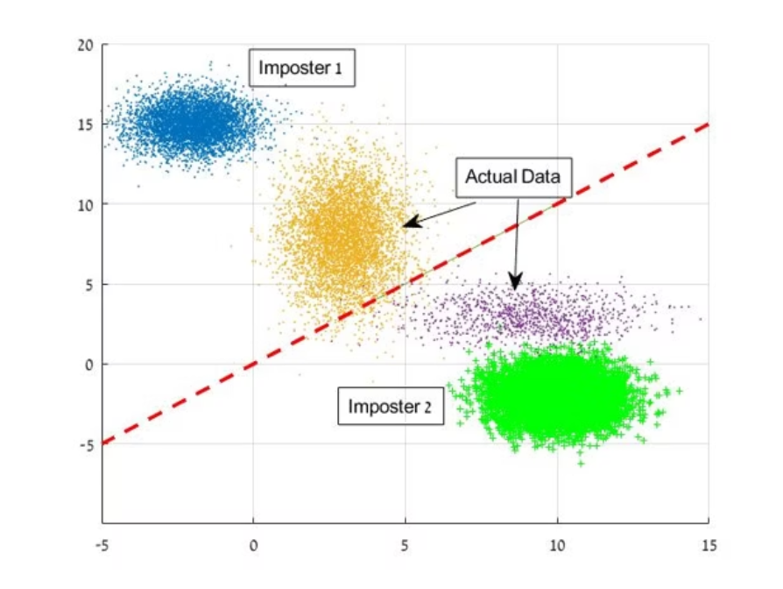

Stylistic Classification Models
CNN-BiLSTM Model
Combines convolutional neural networks to extract local textual patterns with bidirectional LSTM networks to preserve long-range dependencies. This hybrid architecture effectively captures both n-gram features and sequential context.
BERT Classifier
Leverages transformer architecture for contextual embeddings and classification. Excels at detecting nuanced stylistic differences through pre-trained language understanding and targeted fine-tuning for style classification.
Both models are trained to distinguish between two impostor corpora. Once trained, they are applied to the target document to assess how each text segment aligns stylistically with either impostor, producing a signal of stylistic variation.

Slide 11

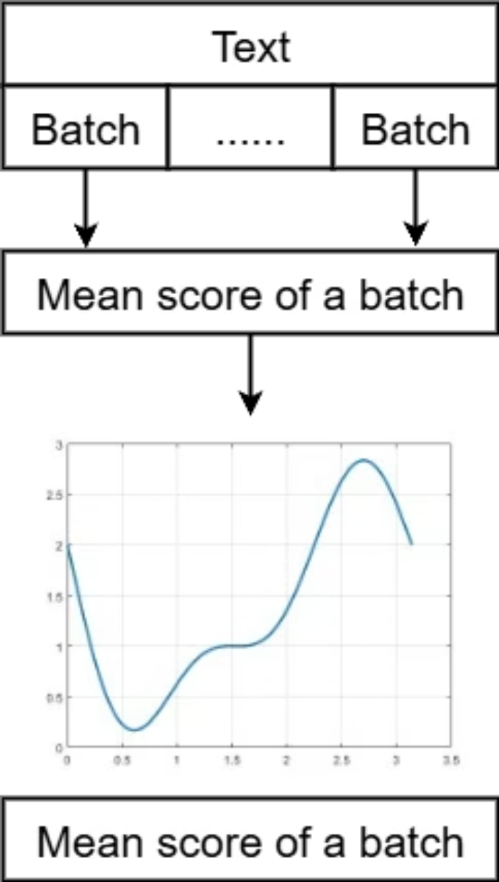
Stylistic Signal Construction
1
Batch-Level Classification
Generate probability scores for each batch against impostor corpora
2
Chunk-Level Aggregation
Combine batch probabilities into chunk scores
3
Continuous Signal Generation
Create a continuous signal reflecting stylistic alignment
4
Signal Interpretation
Analyze the signal for stylistic consistency and identify sharp transitions. These shifts indicate candidate change points later validated through statistical analysis.

Slide 12





Changepoint Detection
Rolling Distance Calculation
Compute average squared stylistic differences between consecutive chunks to identify potential transition points in the document's stylistic flow.
Changepoint Identification
Apply a Discrete Wavelet Transform (DWT) to the rolling distance signal to extract multi-scale detail coefficients. Identify local maxima in these coefficients as statistically significant stylistic shifts.
Consensus Voting
Apply a majority voting mechanism across multiple classifier outputs to validate peaks and ensure reliable, robust detection of genuine stylistic changes.
Boundary Finalization
Establish final stylistic boundaries based on consensus results, providing clear demarcation of stylistic shifts within the document.

Slide 13

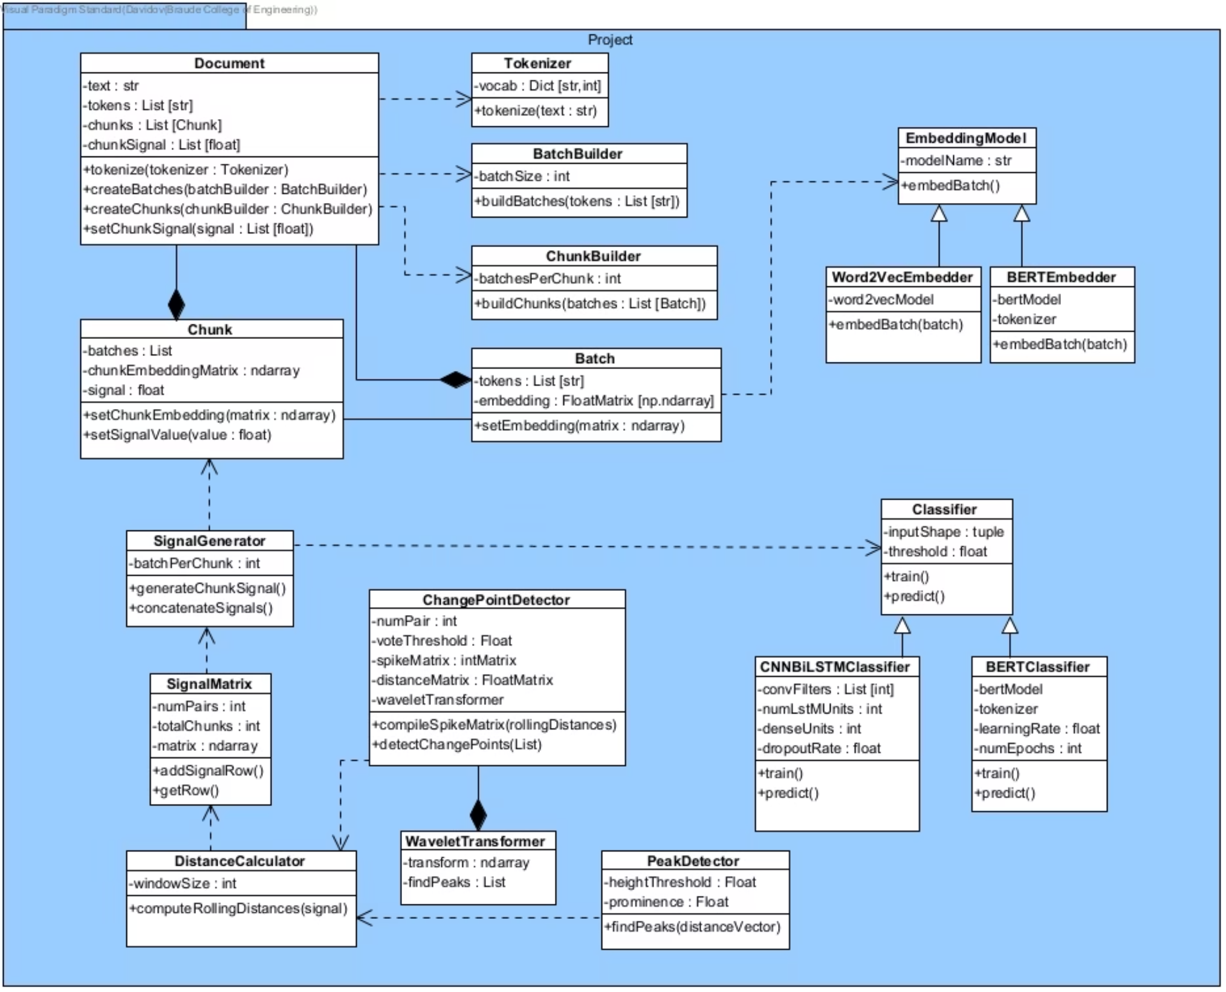
UML - Class Diagram

Slide 14

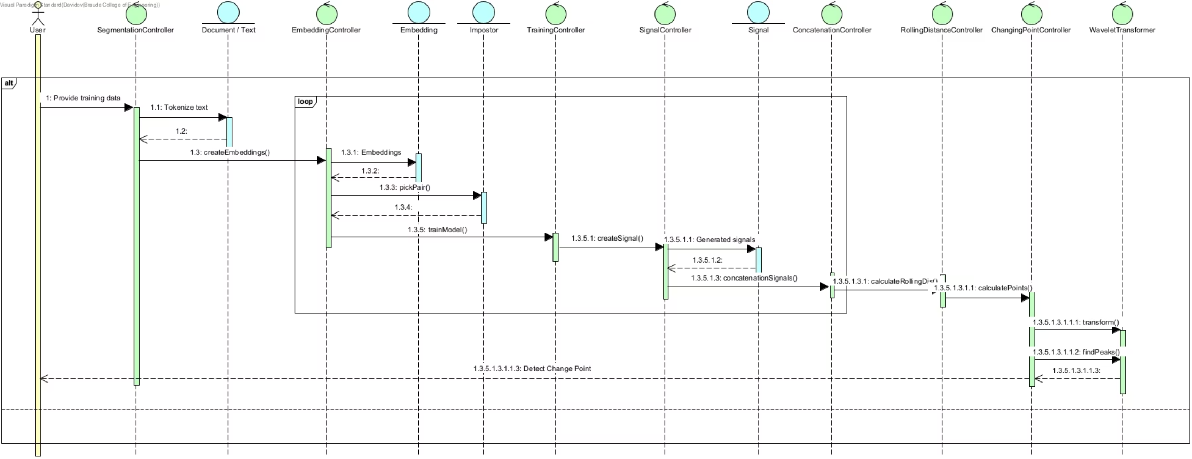
UML - Sequence Diagram

Slide 15

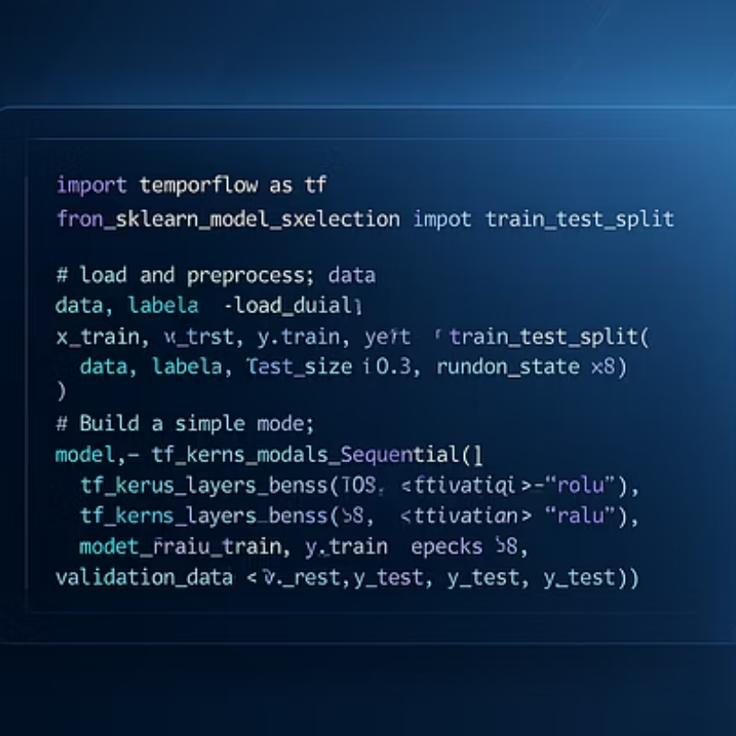
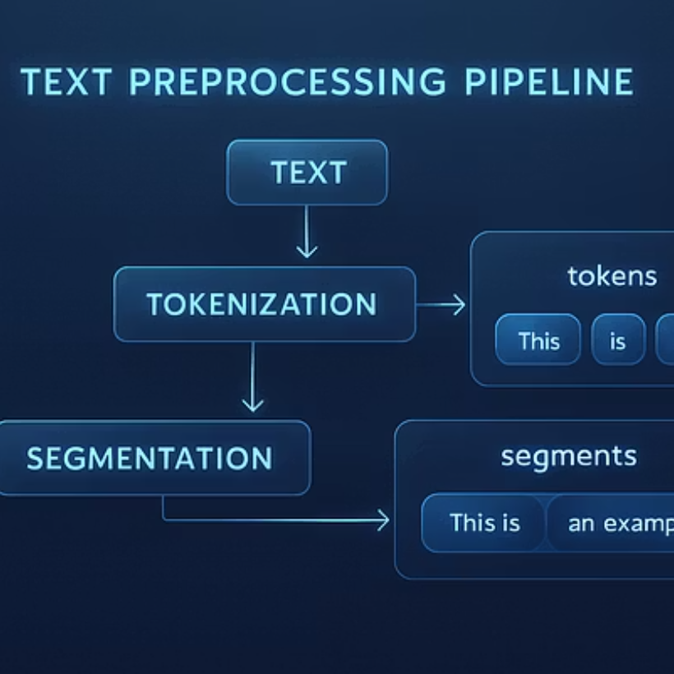
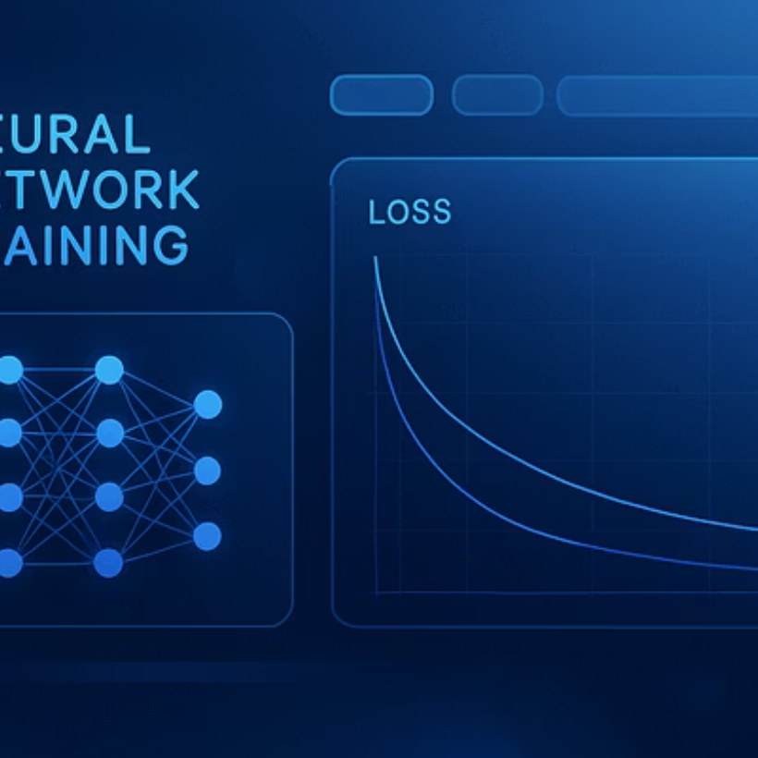
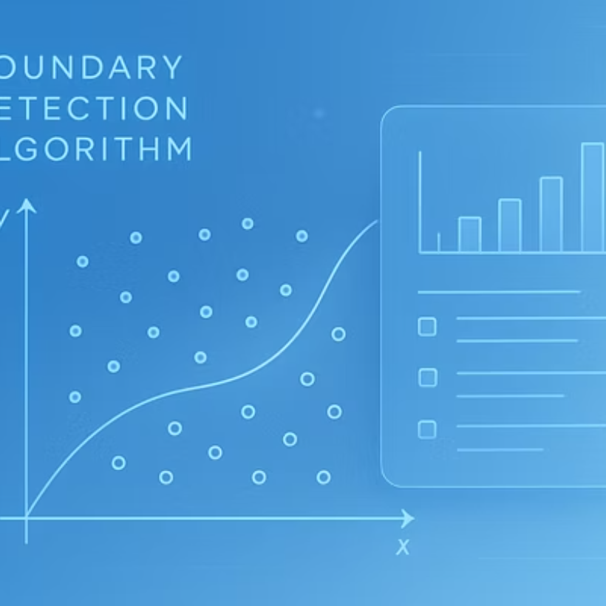
Implementation Workflow
The suggested implementation is going to be based on Python 3.10 in the Google Colab environment with a comprehensive technical stack including TensorFlow, scikit-learn, NumPy, pandas, transformers, gensim, and NLTK. The workflow progresses through distinct stages as mentioned on slide 6.

Slide 16




Testing Plan
Testing Objective
Ground Truth Creation
This plan outlines our intended evaluation strategy. No testing has been performed yet. Our testing objective is to verify the system's reliability in identifying stylistic shifts within documents.
We will create synthetic texts with manually annotated boundaries to serve as ground truth for evaluation.
Testing Procedure
Evaluation Metrics
The testing procedure will involve multiple impostor-classifier configurations to ensure robust performance across different scenarios.
Evaluation will focus on precision (accurate boundary detection), recall (complete boundary coverage), and F1-score (balanced performance measure), with particular attention to minimizing false positives while maximizing true positive detection.

Slide 17

Formal Testing Plan
Component
Test/Unit
Input
Expected Output
Evaluation Method
Tokenizer & Batching
Tokenization accuracy, batch integrity
Raw text documents (diverse styles)
Correctly tokenized sequences, fixed-size batches
Manual inspection, assert batch dimensions, vocabulary verification
Embedding Generation
Semantic coherence, dimensional consistency
Tokenized text batches
Contextually relevant numerical vector representations
Cosine similarity for related texts, dimensionality checks
Classifier (CNN/BERT)
Stylistic discrimination accuracy
Embeddings of stylistic chunks, ground truth labels
Correct classification of stylistic origin
Precision, Recall, F1-score against ground truth (synthetic data)
Chunk Aggregation
Correct combination of chunk outputs
Classifier outputs (labels/probabilities)
Coherent, aggregated stylistic representations
Cross-validation with known changes, consistency checks
Signal Generation
Signal robustness and responsiveness
Aggregated chunk data
Clear stylistic signal indicating shifts
Visual inspection of plots on synthetic data with known boundaries
Rolling Distance Calculation
Accuracy of distance metric computation
Stylistic signal data
Quantified stylistic divergence between windows
Numerical validation against manual calculations, sensitivity analysis
Spike/Peak Detection
Precision and recall of boundary identification
Rolling distance signal
Accurate detection of significant peaks
Comparison against ground truth boundaries
Voting Mechanism
Consensus formation for final boundaries
Multiple impostor-classifier boundary proposals
Consolidated, robust final stylistic boundaries
Agreement rate, F1-score on combined results vs. ground truth
Evaluation Metrics
Correctness of metric calculations
Detected and ground truth boundaries
Accurate Precision, Recall, F1-score
Manual verification, comparison with standard library implementations

Slide 18




Evaluation Methodology
Dataset Preparation
We create test documents by concatenating distinct author segments with clear stylistic differences. These documents are then manually annotated to establish ground truth boundaries that serve as the reference for our evaluation metrics.
Performance Metrics
Our evaluation employs precision, recall, and F1-score metrics with a margin of error (±1 chunk) to account for minor inaccuracies in boundary detection. This approach provides a comprehensive assessment of the system's detection capabilities.
Visualization
We plot stylistic signals with both predicted and actual boundary indicators, enabling visual comparison of system performance against ground truth and facilitating intuitive understanding of detection accuracy.

Slide 19
Innovation & Contributions
The following outlines how we believe our proposed approach may offer methodological innovation and real-world value as the project develops.
Methodological Innovation
Scientific & Practical Contribution
Our approach introduces deep neural networks into the impostor methodology, creating a novel unsupervised and interpretable stylistic segmentation framework. This may represent a meaningful advancement over traditional methods that rely on supervised learning or basic statistical techniques.
If successful, the system could enhance the analysis of complex, multi-authored texts, supporting transparency in literary forensics, digital editing, and plagiarism detection. These capabilities would be valuable in both academic and practical content verification contexts.
Enhanced multi-author text analysis
Integration of deep learning with impostor techniques
Improved literary forensics tools
Unsupervised boundary detection
Advanced plagiarism detection
Interpretable stylistic analysis

Slide 20
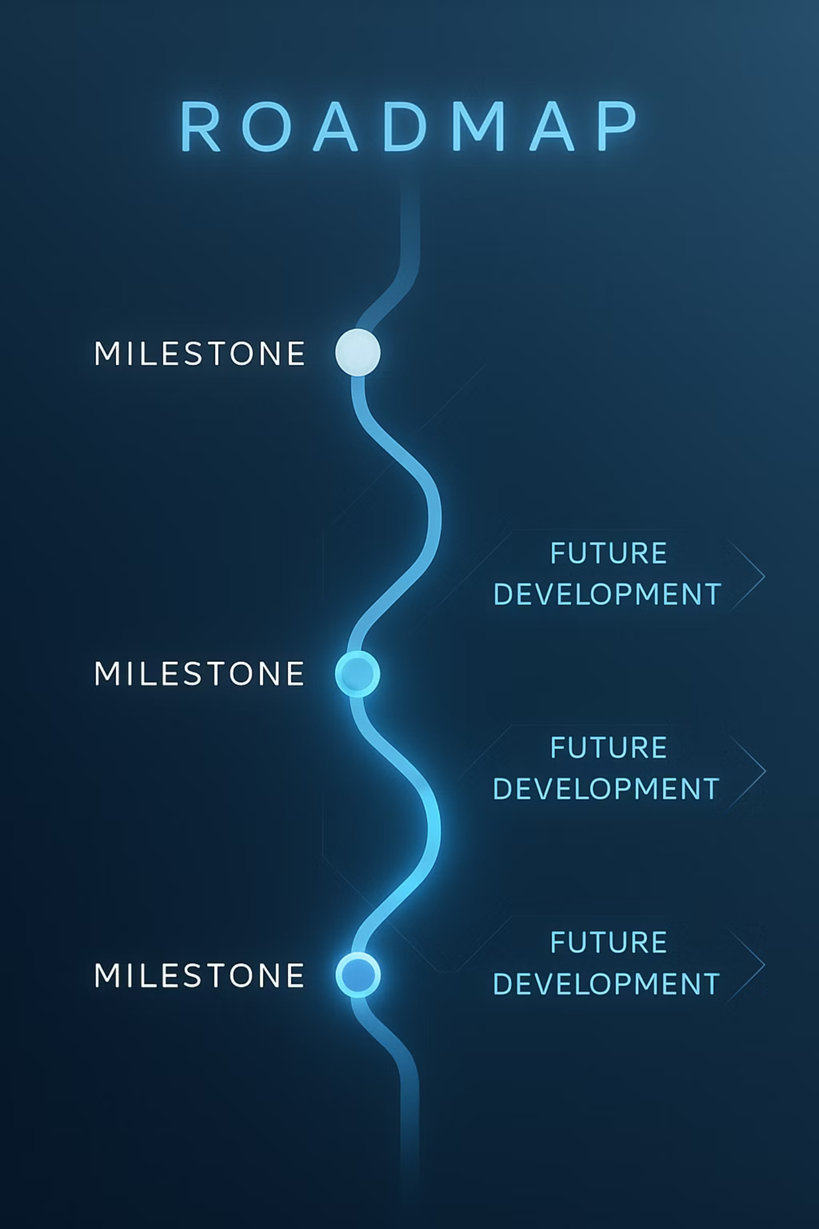
Summary and Future Directions
Phase A Achievements
Phase B Next Steps
Clear definition of stylistic segmentation problem
Comprehensive classifier training and optimization
Developed robust deep impostor-based pipeline
Large-scale real-world testing and benchmarking
Established testing and evaluation framework
Fine-tuning voting mechanisms for accuracy
Explore multilingual and cross-genre generalization
At the end of Phase A, we have defined the stylistic segmentation problem and designed a comprehensive solution approach using deep impostor methods. Our robust pipeline and evaluation framework provide a solid foundation for further development.
Moving forward, we will focus on optimizing classifiers, conducting extensive real-world testing, refining our boundary detection mechanisms, and exploring applications across different languages and genres to enhance the system's versatility and practical utility.

Slide 21

Thank You
Acknowledgments
Special thanks to Dr. Renata Avros and Prof. Zeev Volkovich for guidance and support throughout this research project. Additional appreciation to Braude College Software Engineering Department for providing resources and academic environment.
Contact Information
For questions, feedback, or collaboration opportunities, please reach out to Ofir Uziel. Your insights and suggestions are valuable for the continued development of this research.
Questions Welcome
Thank you for your attention! We welcome any questions about the methodology, implementation details, or potential applications of our stylistic analysis framework.

